Slide 1

File and Printer sharing in Windows NT Environment
NATIONAL INSTITUTE OF ELECTRONICS AND INFORMATION TECHNOLOGY
Birla Farms, Bada Phull, Ropar
NIELIT ‘O’-Level
IT Tools and Network basics

Slide 2
Artificial Intelligence

Slide 3
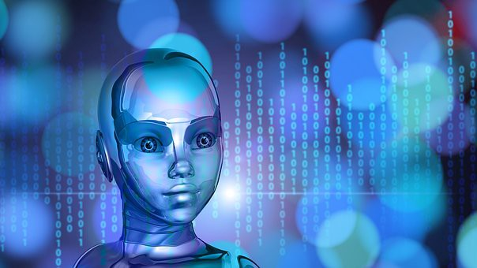
Index
Introduction
What is AI
Goals of AI
Type of Artificial Intelligence
Artificial Intelligence
Machine Learning
Deep Learning
Components that contribute to build an Intelligent system
Application of AI
Advantages of AI
Disadvantages of AI

Slide 4
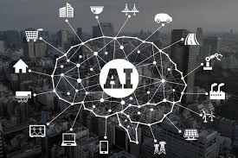
Artificial Intelligence
Humans have developed the power of computer systems in terms of their diverse working domains, their increasing speed, and reducing size with respect to time. Since the invention of computers or machines, their capability to perform various tasks has grown tremendously
A branch of Computer Science named Artificial Intelligence pursues creating the computers or machines as intelligent as human beings.
For example, discovering proofs for mathematical theorems or playing chess

Slide 5
What is AI
Artificial intelligence exists when a machine has cognitive ability.
The machine has the ability to perform cognitive functions such as perceiving, learning, reasoning and problem solving
The benchmark for AI is the ability of machine having human level reasoning, speech and vision.

Slide 6
What is AI
According to father of Artificial Intelligence John McCarthy, AI can be defined as
The science and engineering of making intelligent machines, especially intelligent computer programs
AI is accomplished by studying how human brain thinks, learn, decide and work while trying to solve a problem, and then using the outcomes of this study as a basis of developing intelligent software and systems.
Artificial Intelligence is a way of making a computer, a computer-controlled robot, or a software think intelligently, in the similar manner the intelligent humans think.

Slide 7
Goals of AI
To Create Expert Systems
The systems which exhibit intelligent behavior, learn, demonstrate, explain, and advice its users.
To Implement Human Intelligence in Machines
Creating systems that understand, think, learn, and behave like humans.

Slide 8
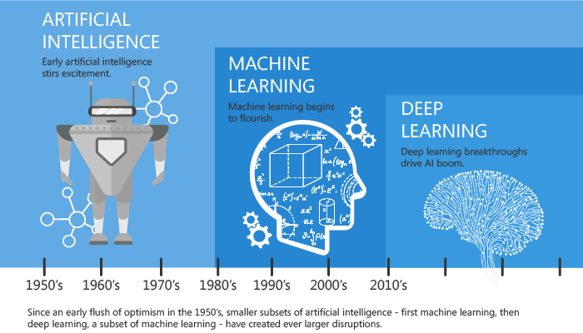
Types Of Artificial Intelligence
Artificial Intelligence is grouped into three subfields:
Artificial Intelligence
Machine Learning
Deep Learning

Slide 9
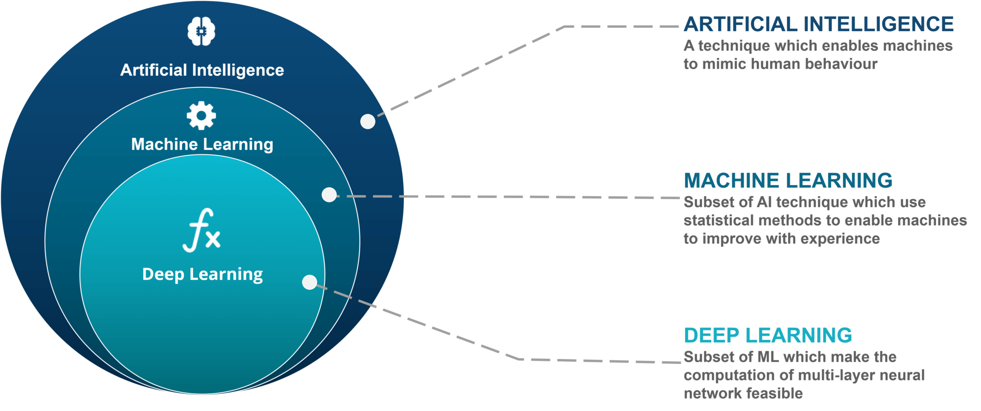
Types Of Artificial Intelligence

Slide 10
Machine Learning
Its not a
magic pill
"Can machines think?"
is replaced with the question
"Can machines do what we (as thinking entities) can do?"
Alan Turing
“A computer program is said to learn
from experience E with respect to some class of tasks T and performance measure P if its performance at tasks in T, as measured by P, improves with experience E.”
Tom M. Mitchell

Slide 11
Types Of Artificial Intelligence
AI- Artificial Intelligence
It is the science of training machines to perform human tasks
The term was invented in the 1950s when scientists began exploring how computers could solve problems on their own.
AI is a computer that is given human-like properties. Like our brain which works effortlessly and seamlessly to calculate the world around us.
Artificial Intelligence is the concept that a computer can do the same.
It can be said that AI is the large science that mimics human aptitudes.

Slide 12
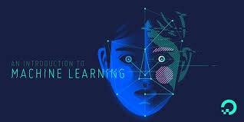
Types Of Artificial Intelligence
Machine learning
It is a subset of AI that trains a machine how to learn
It is the art of study of algorithms that learn from examples and experiences.
Machine learning is based on the idea that there exist some patterns in the data which are to be identified and used for future predictions.
the machine does not need to be explicitly programmed by people. The programmers give some examples, and the computer is going to learn what to do from those samples.
The difference from hardcoding rules is that the machine learns on its own to find such rules.

Slide 13
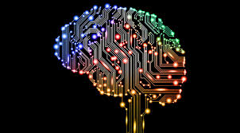
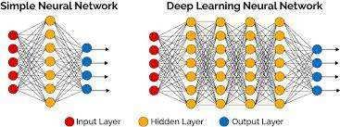
Types Of Artificial Intelligence
Deep learning
It is a sub-field of machine learning.
It means the machine uses different layers to learn from the data.
The depth of the model is represented by the number of layers in the model.
In deep learning, the learning phase is done through a neural network. A neural network is an architecture where the layers are stacked on top of each other.
For example, Google LeNet model for image recognition counts 22 layers.

Slide 14
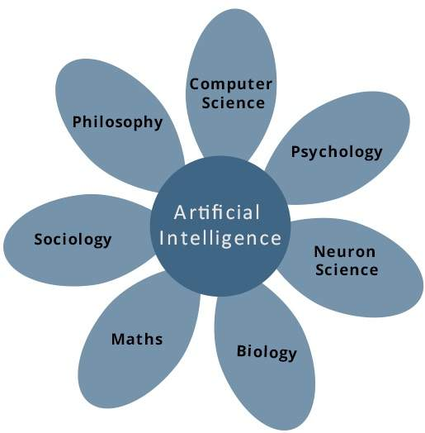
Components that contribute to Build An Intelligent System

Slide 15
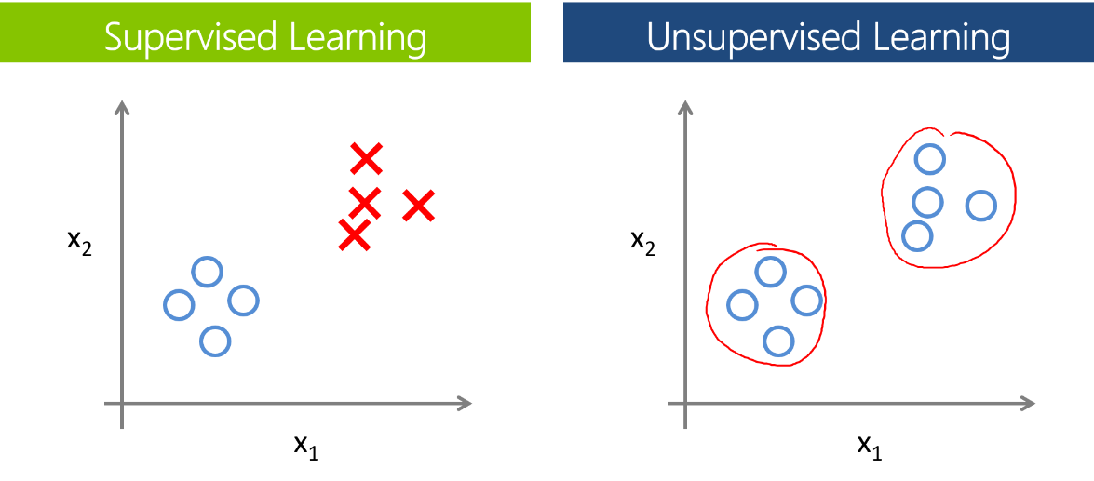
Major Classes of Learning Algorithms
Better to think of machine learning as a means of building models of Data
Learning Algorithm
Supervised Learning
Unsupervised Learning

Slide 16
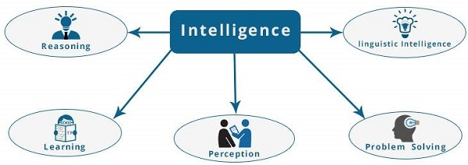
What is Intelligence Composed of
The intelligence is intangible and is composed of following

Slide 17
What is Intelligence Composed of
A machine is Intelligent if it can perform any of these intelligent functions
Reasoning:
It is the set of processes that enables to provide basis for judgement, making decisions, and prediction.
Learning:
It is the activity of gaining knowledge or skill by studying, practicing, being taught, or experiencing something. Learning enhances the awareness of the subjects of the study. For AI enabled systems learning is
Learn by listening or hearing
Learn by remembering sequence of events
Learning by movements of muscles like picking objects, writing etc
Learning from a particular behavioural pattern

Slide 18
What is Intelligence Composed of
Problem Solving
It is the process in which one perceives and tries to arrive at a desired solution from a present situation by taking some path, which is blocked by known or unknown hurdles.
Problem solving also includes decision making, which is the process of selecting the best suitable alternative out of multiple alternatives to reach the desired goal are available.
Perception
It is the process of acquiring, interpreting, selecting, and organizing sensory information.
Perception presumes sensing. In humans, perception is aided by sensory organs. In the domain of AI, perception mechanism puts the data acquired by the sensors together in a meaningful manner.
Linguistic Intelligence
It is the ability to use, comprehend, speak, and write the verbal and written language. It is important in interpersonal communication.

Slide 19
Applications of AI
Gaming
AI plays crucial role in strategic games such as chess, poker, tic-tac-toe, etc., where machine can think of large number of possible positions based on heuristic knowledge.
Natural Language Processing
It is possible to interact with the computer that understands natural language spoken by humans.
Expert Systems
There are some applications which integrate machine, software, and special information to impart reasoning and advising. They provide explanation and advice to the users.

Slide 20
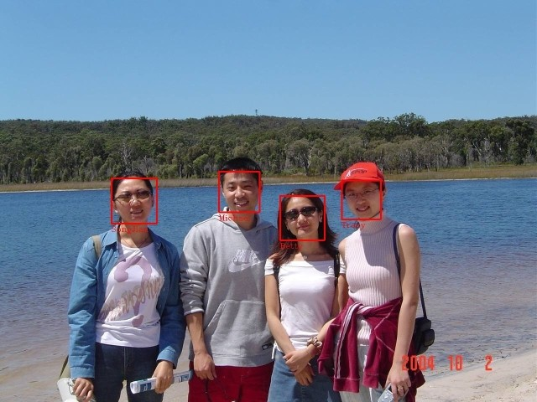
Applications of AI
Vision Systems
These systems understand, interpret, and comprehend visual input on the computer. For example, a spying airplane takes photographs, which are used to figure out spatial information or map of the areas.
Doctors use clinical expert system to diagnose the patient.
Police use computer software that can recognize the face of criminal with the stored portrait made by forensic artist.

Slide 21
Applications of AI
Speech Recognition
Some intelligent systems are capable of hearing and comprehending the language in terms of sentences and their meanings while a human talks to it.
It can handle different accents, slang words, noise in the background, change in human’s noise due to cold, etc.
Handwriting Recognition
The handwriting recognition software reads the text written on paper by a pen or on screen by a stylus. It can recognize the shapes of the letters and convert it into editable text.
Intelligent Robots
Robots are able to perform the tasks given by a human. They have sensors to detect physical data from the real world such as light, heat, temperature, movement, sound, bump, and pressure. They have efficient processors, multiple sensors and huge memory, to exhibit intelligence. In addition, they are capable of learning from their mistakes and they can adapt to the new environment.

Slide 22

Example of Deep Learning
Speech Recognition
Self Driving Car
Robotics
Face Detection
Signature Detection
Customer Discovery
Character Recognition (Multiple cat.)

Slide 23
Advantages of AI
Reduction in Human Error
Humans make mistakes from time to time. Computers do not make these mistakes if they are programmed properly. With Artificial intelligence, the decisions are taken from the previously gathered information applying a certain set of algorithms. So errors are reduced and the chance of reaching accuracy with a greater degree of precision is a possibility.
For example: Weather Forecasting using AI they have reduced the majority of human error.
Risk taking:
This is one of the biggest advantages of Artificial intelligence. We can overcome many risky limitations of humans by developing an AI Robot which in turn can do the risky things for us.
For example: defusing a bomb, explore the deepest parts of oceans, mining for coal and oil, it can be used effectively in any kind of natural or man-made disasters.

Slide 24
Advantages of AI
Available 24x7:
An Average human will work for 4–6 hours a day excluding the breaks. Humans are built in such a way to get some time out for refreshing themselves and get ready for a new day of work and they even have weekly offed to stay intact with their work-life and personal life. But using AI we can make machines work 24x7 without any breaks and they don’t even get bored, unlike humans.
For example: Educational Institutes and Helpline centers are getting many queries and issues which can be handled effectively using AI.
Helping in Repetitive Jobs:
In our day-to-day work, we will be performing many repetitive works like sending a thanking mail, verifying certain documents for errors and many more things. Using artificial intelligence we can productively automate these mundane tasks and can even remove “boring” tasks for humans and free them up to be increasingly creative.
For example: In banks, we often see many verifications of documents to get a loan which is a repetitive task for the owner of the bank. Using AI Cognitive Automation the owner can speed up the process of verifying the documents by which both the customers and the owner will be benefited.

Slide 25
Advantages of AI
Digital Assistance:
Some of the highly advanced organizations use digital assistants to interact with users which saves the need for human resources. The digital assistants also used in many websites to provide things that users want. Some chatbots are designed in such a way that it’s become hard to determine that we’re chatting with a chatbot or a human being.
For example: We all know that organizations have a customer support team that needs to clarify the doubts and queries of the customers. Using AI the organizations can set up a Voice bot or Chatbot which can help customers with all their queries. We can see many organizations already started using them on their websites and mobile applications
Faster Decisions:
Using AI alongside other technologies we can make machines take decisions faster than a human and carry out actions quicker. While taking a decision human will analyze many factors both emotionally and practically but AI-powered machine works on what it is programmed and delivers the results in a faster way.
For example: We all have played Chess games in Windows. It is nearly impossible to beat CPU in the hard mode because of the AI behind that game. It will take the best possible step in a very short time according to the algorithms used behind it.

Slide 26
Advantages of AI
Daily Applications:
Daily applications such as Apple’s Siri, Window’s Cortana, Google’s OK Google are frequently used in our daily routine whether it is for searching a location, taking a selfie, making a phone call, replying to a mail and many more.
For example: Around 20 years ago, when we are planning to go somewhere we used to ask a person who already went there for the directions. But now all we have to do is say “OK Google where is Visakhapatnam”. It will show you Visakhapatnam’s location on google map and the best path between you and Visakhapatnam.
New Inventions:
AI is powering many inventions in almost every domain which will help humans solve the majority of complex problems.
For example: Recently doctors can predict breast cancer in the woman at earlier stages using advanced AI-based technologies.

Slide 27
Disadvantages of AI
High Costs of Creation:
As AI is updating every day the hardware and software need to get updated with time to meet the latest requirements.
Machines need repairing and maintenance which need plenty of costs. It’ s creation requires huge costs as they are very complex machines.
Making Humans Lazy:
AI is making humans lazy with its applications automating the majority of the work.
Humans tend to get addicted to these inventions which can cause a problem to future generations

Slide 28
Disadvantages of AI
Unemployment:
As AI is replacing the majority of the repetitive tasks and other works with robots,human interference is becoming less which will cause a major problem in the employment standards.
Every organization is looking to replace the minimum qualified individuals with AI robots which can do similar work with more efficiency.
No Emotions:
There is no doubt that machines are much better when it comes to working efficiently but they cannot replace the human connection that makes the team.
Machines cannot develop a bond with humans which is an essential attribute when comes to Team Management.
Lacking Out of Box Thinking:
Machines can perform only those tasks which they are designed or programmed to do, anything out of that they tend to crash or give irrelevant outputs which could be a major backdrop.

